Slide 1




Luddy School of Informatics, Computing, and Engineering
Phase 3 - HOME CREDIT DEFAULT RISK - GROUP 11
Bindu Madhavi Dokala
(bdokala@iu.edu)
Jagadeesh Kovi
(jagakovi.iu.edu)
Sai Sathwik Reddy Varikoti
(svarikot@iu.edu)
Pranay Chowdary Namburi
(pnambur@iu.edu)
INDIANA UNIVERSITY BLOOMINGTON

Slide 2
Contents
Project Description and Workflow
Visual EDA
Feature Engineering between tables
Overview of Modeling Pipelines explored
Hyperparameter Tuning and Feature Selection
Results
Discussion and Future Work
Conclusion

Slide 3
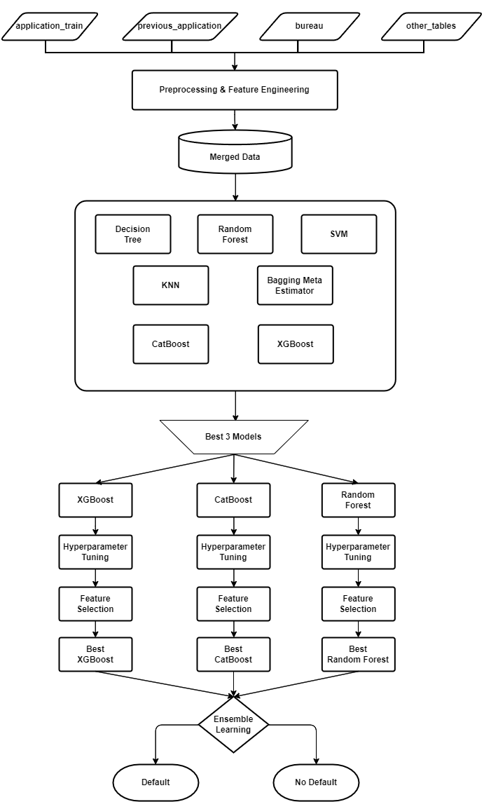
Project Description and Workflow
In the current phase of our project, we conducted EDA to find the strongly correlated features. Then we did feature engineering and selection and experimented with a range of machine learning algorithms such as logistic regression, random forests, KNN, decision trees, and ensemble methods like voting and stacking classifiers
We fine-tuned these models using hyperparameter optimization and feature selection to select the best performing model. We then compared the performances of these models to establish the best performing model. Our efforts are directed towards aiding Home Credit in making informed lending decisions, reducing the frequency of unpaid loans, and expanding access to financial services for those with minimal banking history, ultimately contributing to economic inclusion

Slide 4
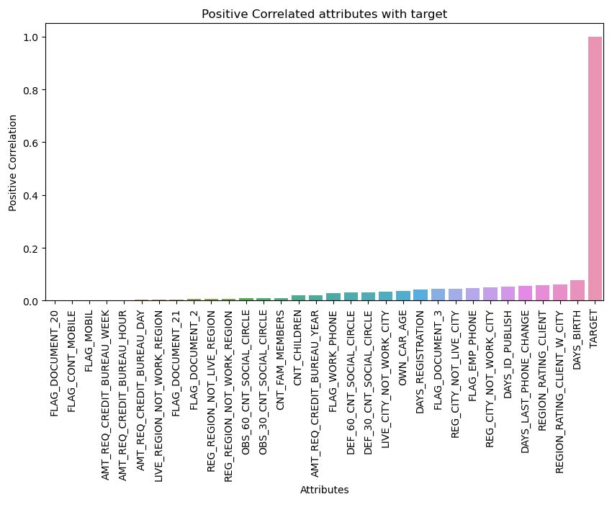
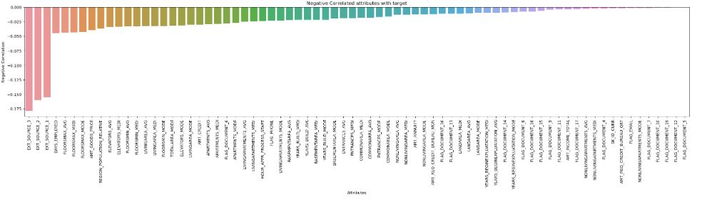
Visual Exploratory Data Analysis
Visual Exploratory data Analysis performed on Categorical values to understand their significance in data.
And analyzed relevant features with respect to target variable. Showing some visualizations on the right.
The graphs below depict the column features which are Positively correlated and Negatively correlated, based on target.

Slide 5
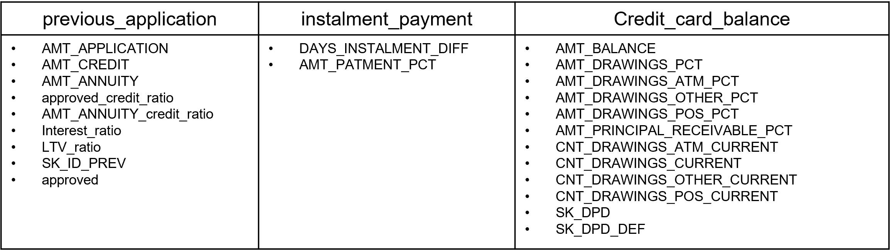
Feature Engineering between tables
Feature Engineering is done on “previous_application”, “instalment_payment”, and “Credit_card_balance” tables.
These following features have been engineered and selected.

Slide 6
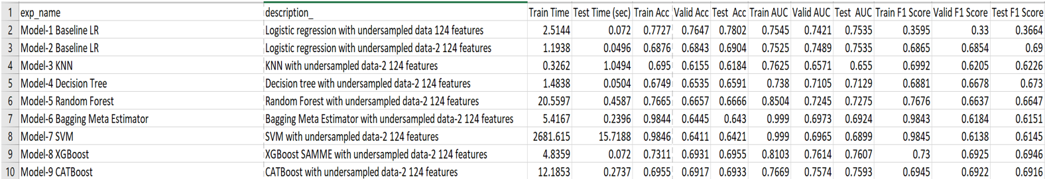
Overview of Modeling Pipelines explored

Slide 7
Hyperparameter Tuning and Feature Selection
Performed hyperparameter tuning for the selected models: CatBOOST, XGBOOST and Random Forest using GridSearchCV from sklearn.ensemble.
Defined a function ConductGridSearch that takes the training and test data as input, and then runs a grid search with different parameter combinations for the mentioned classifier models.
We have selected the features based on their importance values considering different thresholds(eg: 0, 0.01, 0.005).
We have experimented with different thresholds for among various selected models

Slide 8
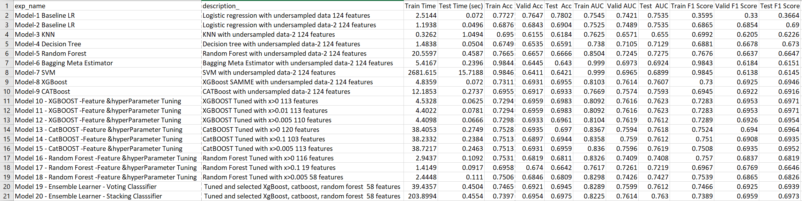
Results

Slide 9
Discussion & Future Work
In our analysis of model performances, we observe a pronounced overfitting in the Bagging meta estimator (Model 6), indicated by high training accuracy (0.9844) and F1 score (0.9843), but this does not translate to validation or test performance, where accuracy drops to 0.6445 and 0.6924, respectively, with F1 scores also decreasing.
Conversely, KNN (Model 3) and SVM (Model 7) show signs of underfitting, with both training and validation scores being considerably lower, for instance, KNN's training accuracy is at 0.6950 with an F1 score of 0.6992.
Standout performances are noted in ensemble learners such as the voting classifier (Model 19) and stacking classifier (Model 20), as well as in the finely tuned versions of XGBOOST (Models 10, 11, and 12), CatBOOST (Models 13, 14, and 15), and Random Forests (Models 16, 17, and 18), all of which outpace the other models by achieving higher accuracy, AUC, and F1 scores.
Accuracy, AUC, and F1 scores may improve with more optimization and tuning of the promising ensemble learners and tuned random forest models.

Slide 10

Conclusion
We continued from where we left off in Phase 2. We performed feature engineering, feature selection and hyper parameter tuning and experimented on a range of machine learning algorithms. Our experiments help compare these models' performance and identify the most effective pipeline to minimize the default risk.
Till now, based on our experimentation, we have determined that the ensemble learning methods (Model 19 & Model 20) outperformed all other models. These methods combined the predictions of XGBoost, CatBoost, and Random Forest using Voting Classifier and Stacking Classifier. The results showed that these models achieved the highest test F1 scores, 0.6939 and 0.6973, respectively. Additionally, this method has the greatest test AUC of 0.7612 and 0.763 for the stacking classifier and the voting classifier, respectively. This indicates that employing ensemble methods improved the ability to distinguish between positive and negative classes.
The phase's findings imply that ensemble learning methods might work well for this classification problem.
Kaggle Submission & Scores

Slide 11
Thank you

